Slide 1
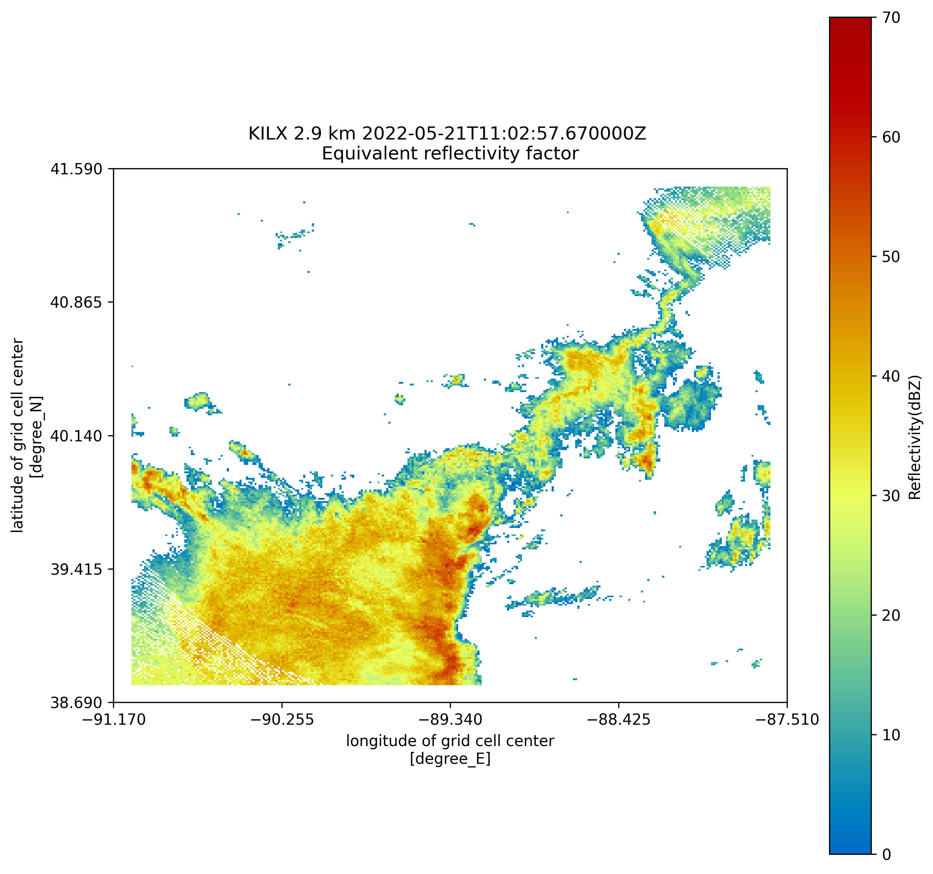
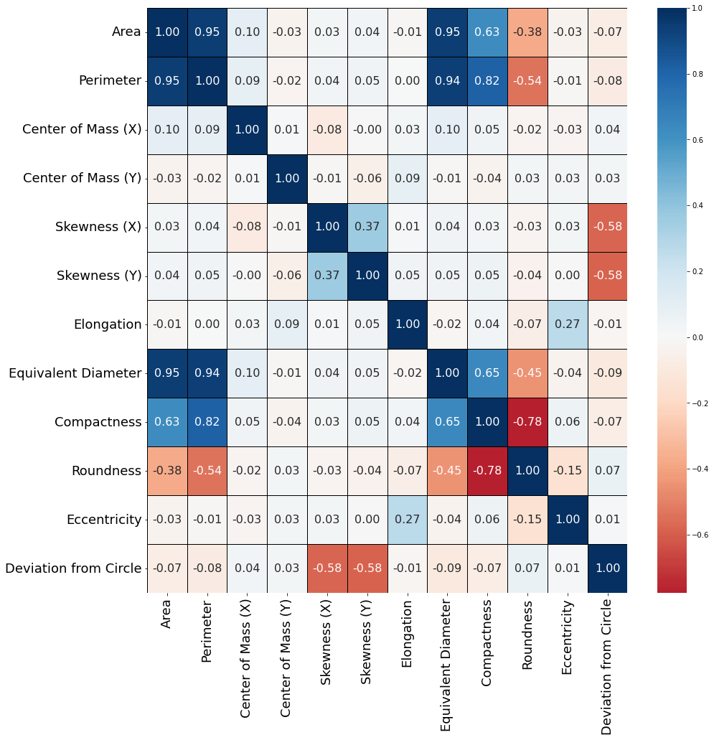
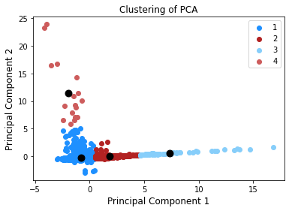
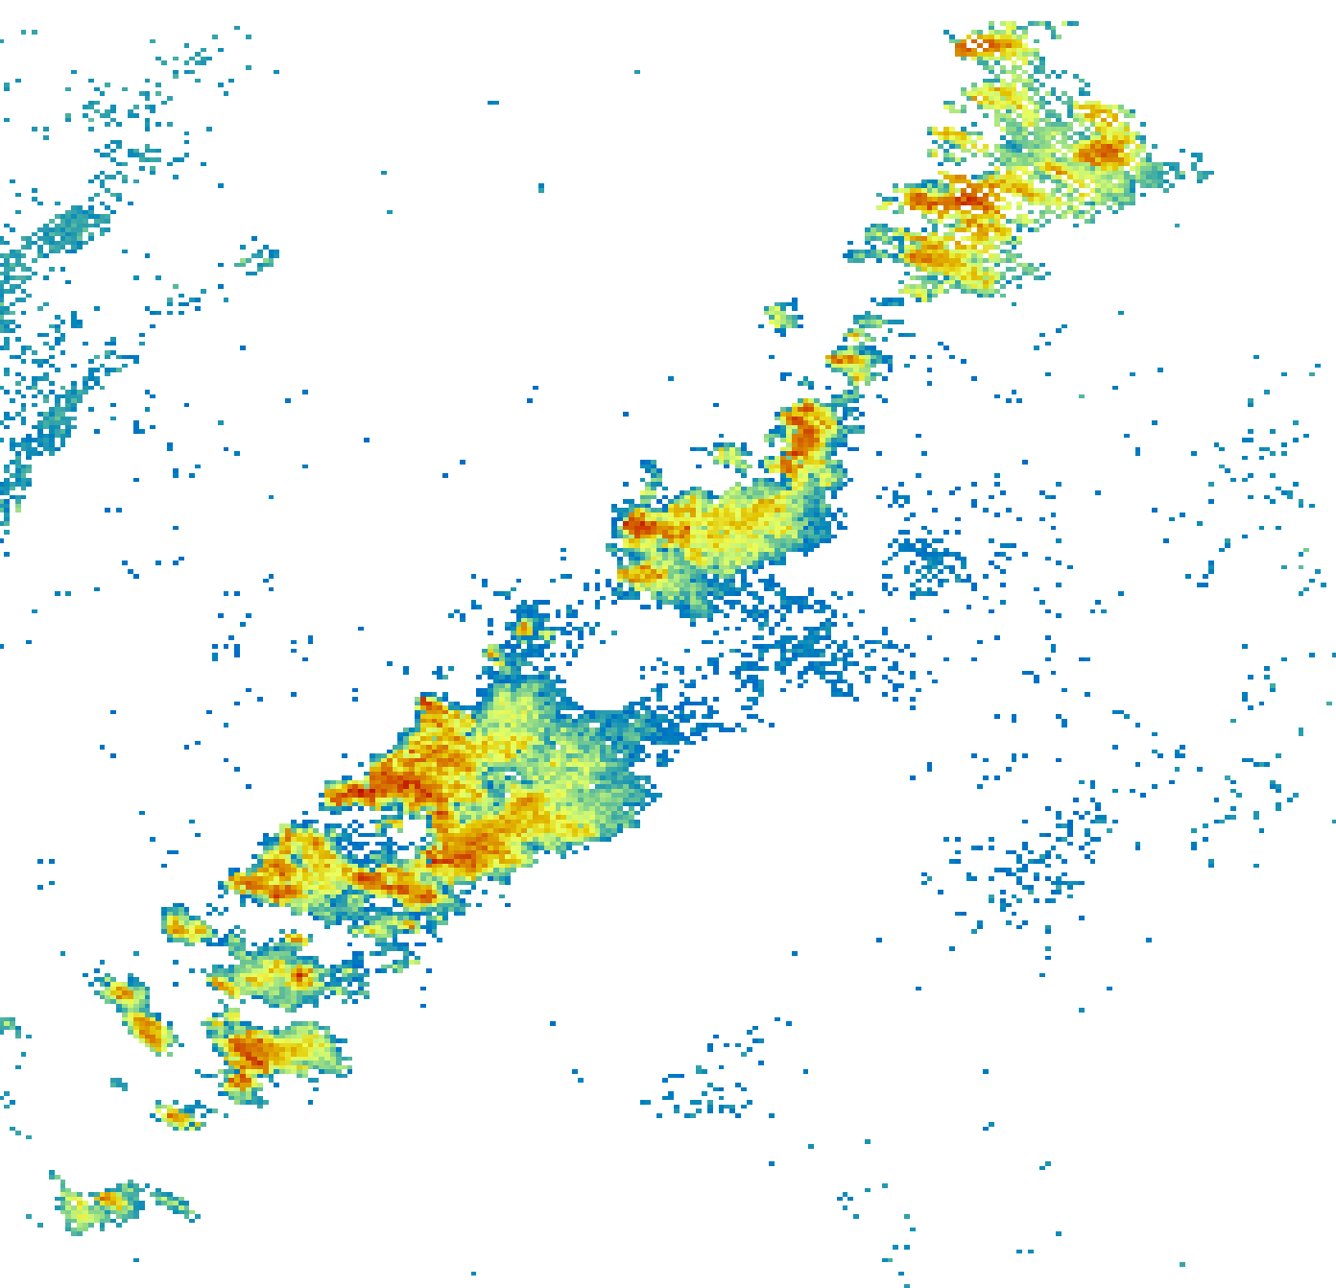
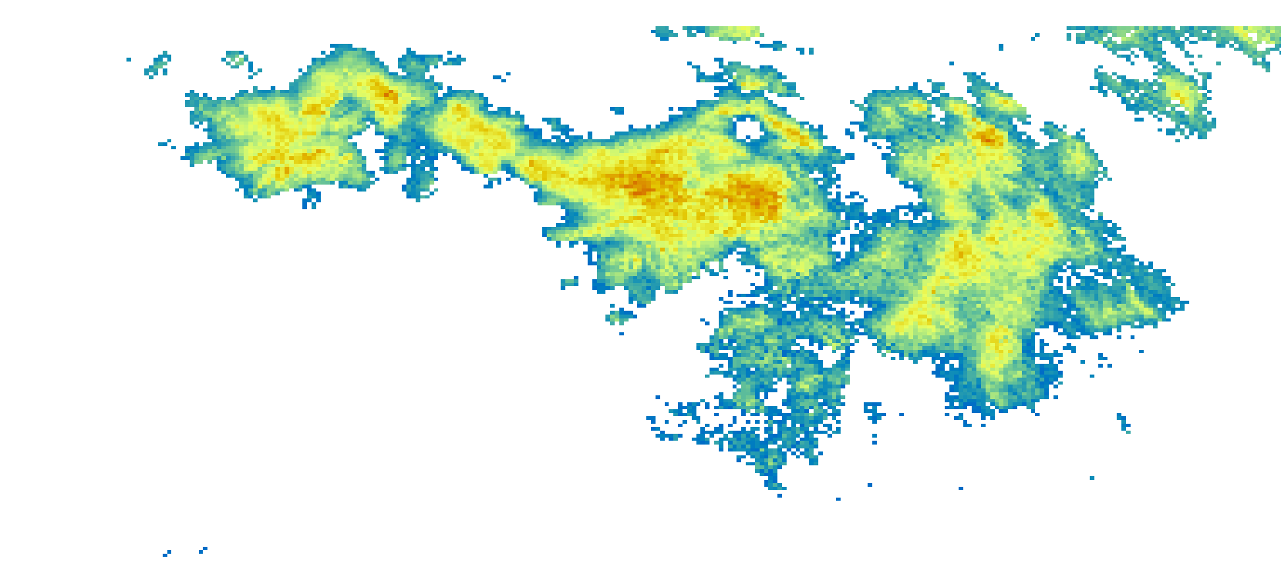
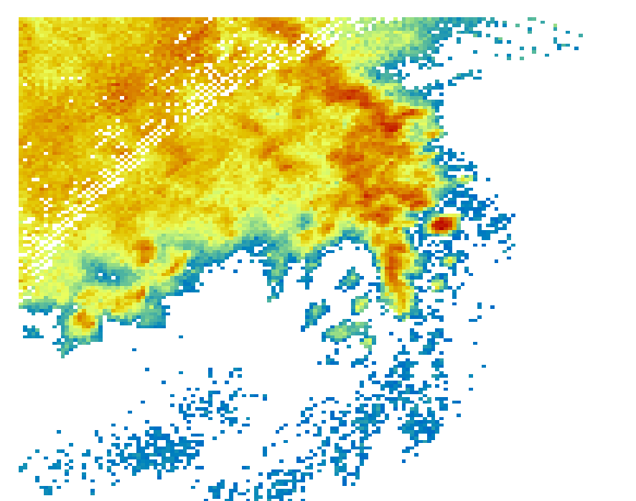
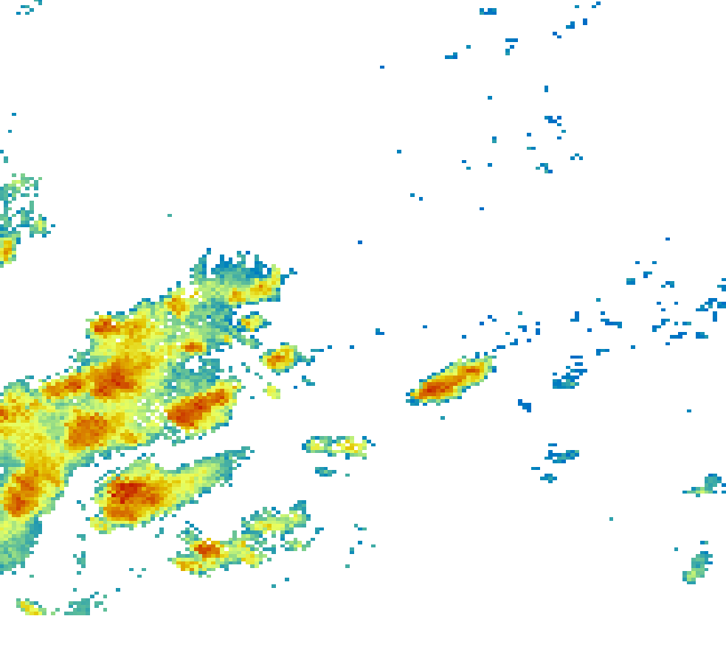
Objective analysis of storm morphology in radar data
Magdelyn Zoerner, Robert Jackson, Bhupendra Raut
Argonne National Laboratory, Environmental Science Division
Background and Motivation
The morphology of convective storms is influenced by atmospheric dynamics and can provide important information regarding storm’s influence on its environment.
Numerical weather prediction models have difficulties with predicting storm morphology.
Current analyses of morphology include manual classification, or an automated computation of a basic measurement.
Purpose: to determine whether the automated identification and classification of storm morphology is feasible.
Fig. 1: NEXRAD reflectivity from KILX radar site.
Results
Cluster 1 Sample
Cluster 2 Sample
Fig. 3: Clustering of radar images along principal component axes.
Cluster 3 Sample
Cluster 4 Sample
Fig. 2: Correlation matrix indicating degree of correlation between morphological parameters.
Methodology
Morphological image analysis is commonly used to identify and categorize shape objectively.
Process:
Tools and Data:
Next Generation Weather Radar (NEXRAD) Level II reflectivity data from Summer 2020 at KILX.
Python and associated packages (Py-ART, OpenCV, scikit-learn)
Future Applications
The U.S. Department of Energy developed the Atmospheric Radiation Measurement (ARM) user facility to enhance our understandings of climate and our surrounding environment.
We hope to provide a database of these classifications of convective systems for radar data from ARM to improve the accuracy at which storm morphology is predicted. Many of the parameters calculated are invariant to scale, translation, and rotation, and therefore can be applied to various types of atmospheric data besides radar (i.e., satellite).
We also hope to expand this work to develop a Python package that can perform automated morphological analysis of convective systems.
Image Processing
Statistical Analysis
Machine Learning
References
Lane, T.P. (2021). Does lower-stratospheric shear influence the mesoscale organization of convection? Geophysical Research Letters, 48, e2020GL091025. https://doi. org/10.1029/2020GL091025
Pscheidt et al. (2019), How organized is deep convection over Germany? Q J R Meteorol Soc. 145:2366-2384. https://doi.org/10.1002/qj.3552
Acknowledgements
This work was supported in part by the U.S. Department of Energy, Office of Science, Office of Workforce Development for Teachers and Scientists (WDTS) under the Science Undergraduate Laboratory Internships (SULI) program. Special thanks to my mentors, Robert Jackson and Bhupendra Raut for all their support.
Notes:
Pitfalls:
* Only shape of the convective part of the storm, not stratiform or direction
- Need to also consider broken, stratiform, storm motion, no smoothing, no opening/closing

